Slide 1

NHS Jobs Doctor Related London 2019
Power BI Project
Database Source: www.kaggle.com

Slide 2

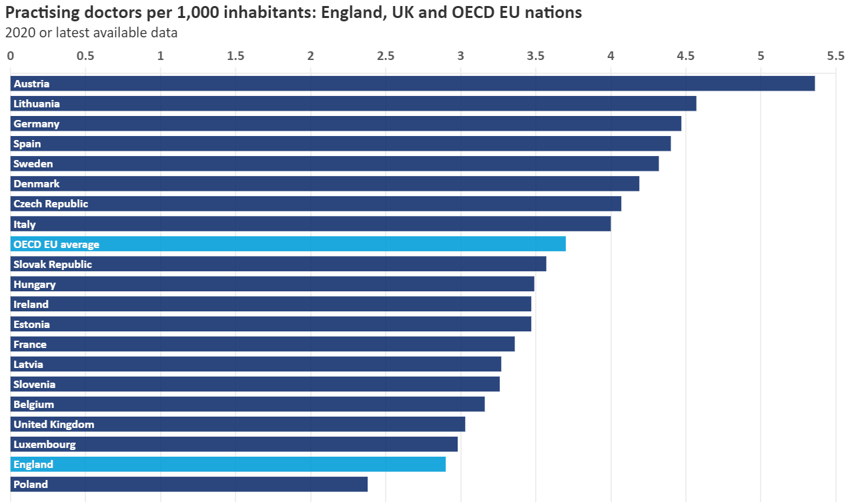
In comparison to other nations, England has a very low proportion of doctors relative to the population. The average number of doctors per 1,000 people in OECD (Organization for Economic Cooperation and Development) EU nations is 3.7, but England has just 2.9.
The British Medical Association (BMA) is the trade union and professional body for doctors in the UK.

Slide 3

Context
This dataset was downloaded from www.Kaggle.com and the contributor scraped it from the NHS jobs website.
The dataset is valuable to those who seek to understand the job market of doctors for the NHS within London area.
Content
This data only includes jobs that were deemed as being related to doctors.
Acknowledgements
The NHS.

Slide 4

Data Cleaning Steps
Original dataset had 27,000 rows
Doctor related jobs posted during several years
Involved a lot a data cleaning
Filtered to only show results for 2019 and only London area
Removed duplicate columns
Renamed and reordered columns
Replaced values – approx. 300 values replaced
Split columns by digit to non-digit, by delimiter and by character transition

Slide 5
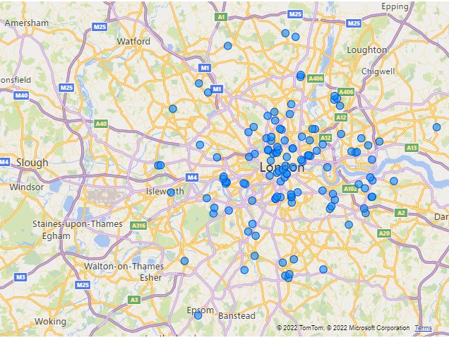

Doctor related job adverts London area 2019

Slide 6
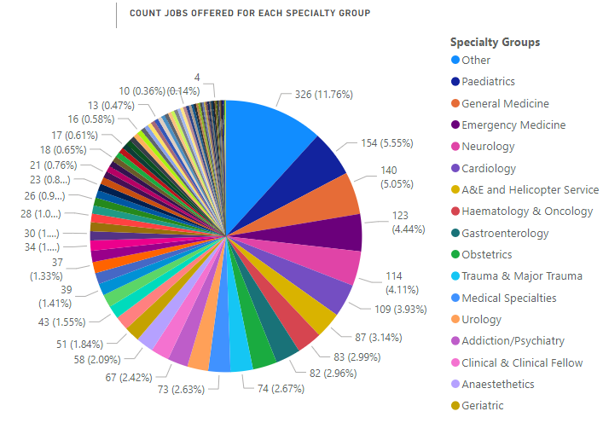
Main areas of shortages are Pediatrics, General Medicine, Emergency Medicine, Neurology, Cardiology, A&E and Helicopter Service, Hematology & Oncology, Gastroenterology and so on.

Slide 7
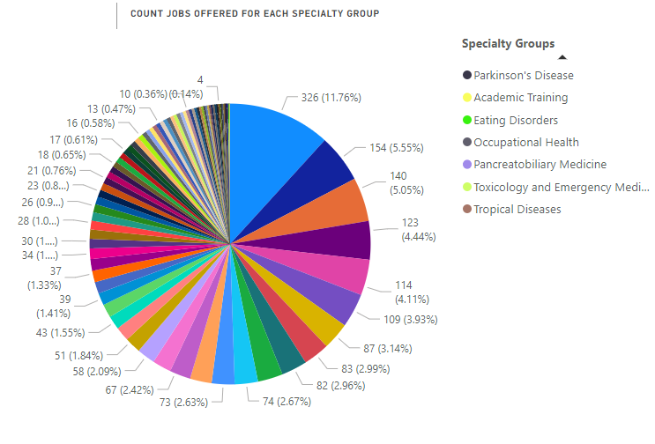
At the bottom of the list with the least amount of jobs offered are the following specialty groups: Parkinson’s Disease, Academic Training, Eating Disorders, Occupational Health etc.
Note: same graph as the previous slide.

Slide 8
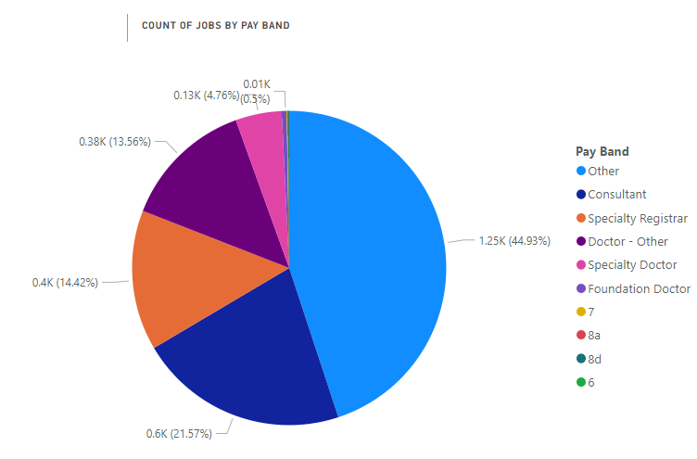

Slide 9
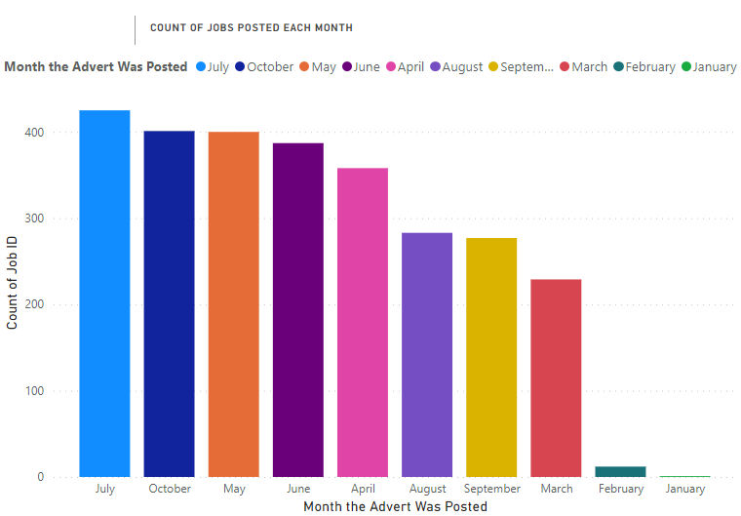
April, May, June, July and October are the months with the most jobs advertised probably because of the new allocated budget as the financial year starts on the 1st of April of each year.
March, August and September are also months with a good number of jobs offered which can be either because the budget needs to be consumed at the end of the year i.e., March or in preparation of Winter Pressures (August and September).
January and February have the lowest number of jobs offered; it can be because it is right after the holiday season which makes it difficult to recruit because most of the NHS staff can’t book annual leave in December, so they probably take it after the holidays.

Slide 10
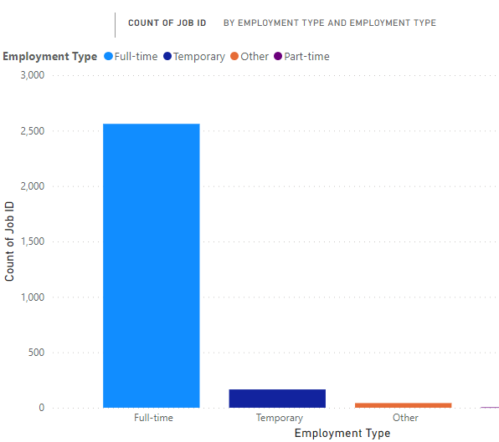
Full time jobs don’t offer much flexibility
Part-time jobs offered are almost non-existent
Temporary jobs don’t offer stability

Slide 11
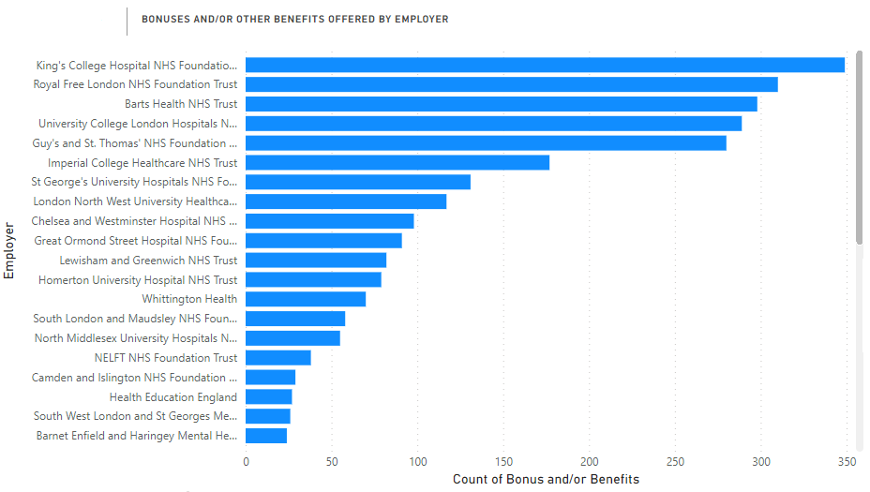

Top of Hospitals that offer the most Bonuses and/or Benefits

Slide 12
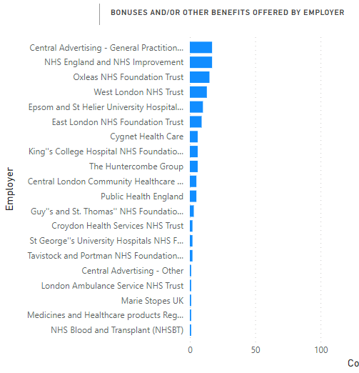

Slide 13
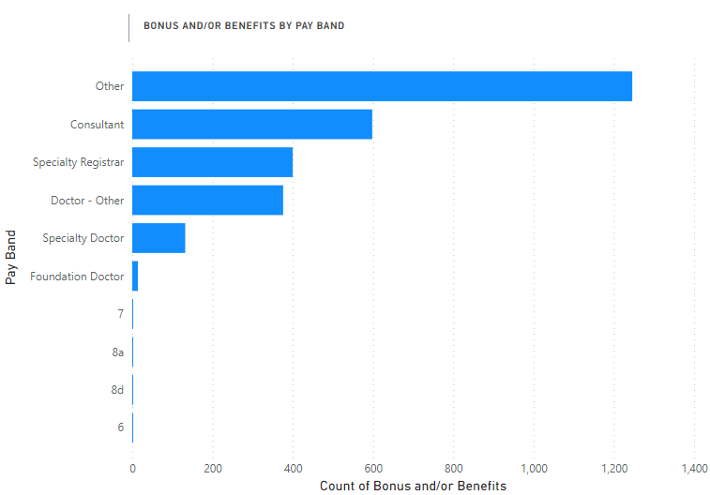

Slide 14

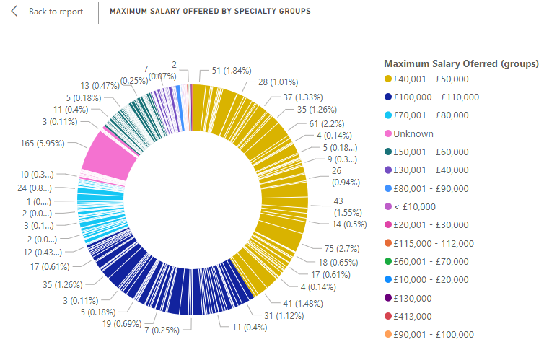

Slide 15

Goals - Recruitment and retention of medical workforce
Most of the jobs offered are fulltime; doesn’t offer too much flexibility.
Why only some hospitals are offering extra payments and/or bonusses?
Why only some pay bands are receiving extra payments and/or bonusses?
Why the number of jobs advertised differ each month and what are factors that cause this?
Why some departments advertise jobs more than others? Any particular reasons?
Why most of the jobs offered are for consultants, Specialty Registrar and then on the third place are the jobs for Foundation Doctors?

Slide 16

Conclusion
The most valuable resource the health service has is its staff. Yet the NHS is in the midst of a chronic workforce crisis, driven by years of insufficient investment in training new staff, inadequate workforce planning, and lack of government accountability (source: BMA website)

Slide 17


Slide 18


